Slide 1
Ship motion prediction with deep learning
Lance De Waele

Slide 2
Contents
Introduction & Goal
Implementation (1st semester)
Data & preprocessing
Model Training & Testing methods
Proposed Models
Performance & Results
Conclusion
Implementation (2st semester)

Slide 3
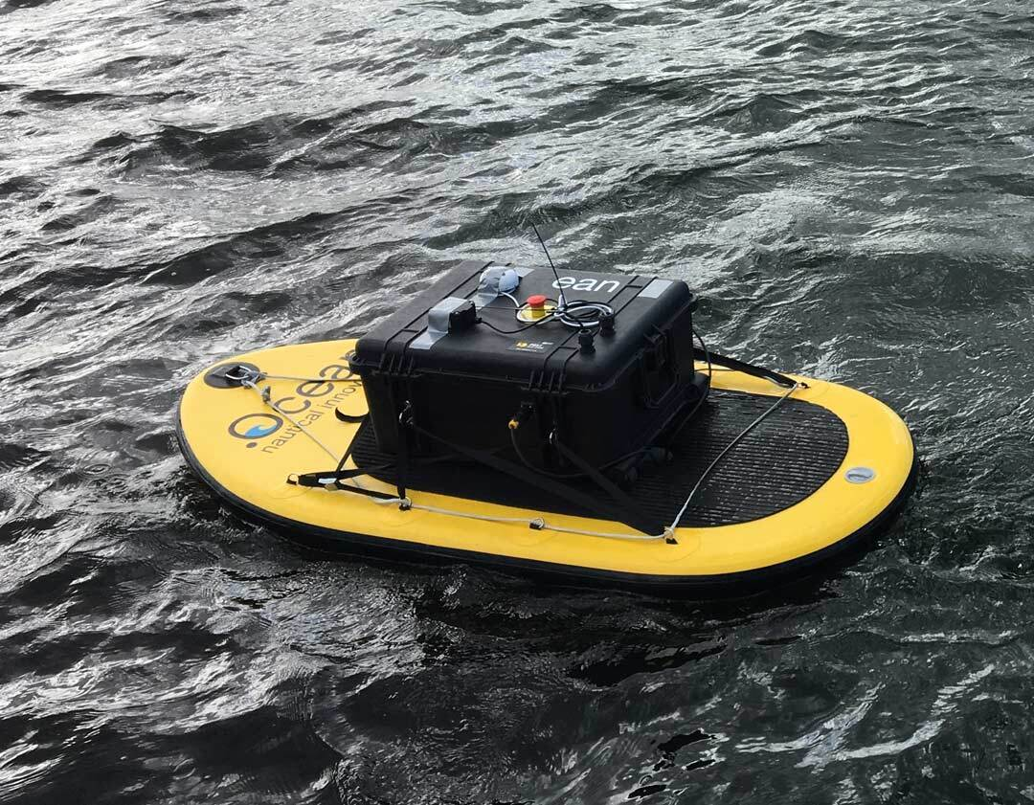
Introduction
Royal Military Academy
Robotics & Autonomous Systems lab
Marsur
Developing an autonomous surface vessel (ASV)
Marland
Developing an autonomous drone
Take off and landing on moving vessels

Slide 4
Goal
Predict the motion of the ASV
Define optimal moment to land drone
Deck stabile and level
Moment with minimal impact
Input (ZED mini sensor):
IMU live data
Stereo camera live video
Output:
Sequence of Pitch, Roll and Heave
Up to 30 seconds ahead

Slide 5
Implementation (1st semester)
Evaluate the input and output data
Test different existing deep learning models
Define criteria for our case
Reference: best performing model
Baseline: worst performing model
Speed: real-time possible?

Slide 6
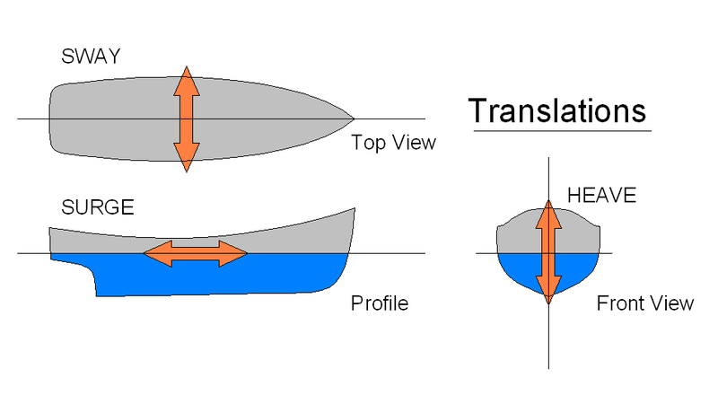
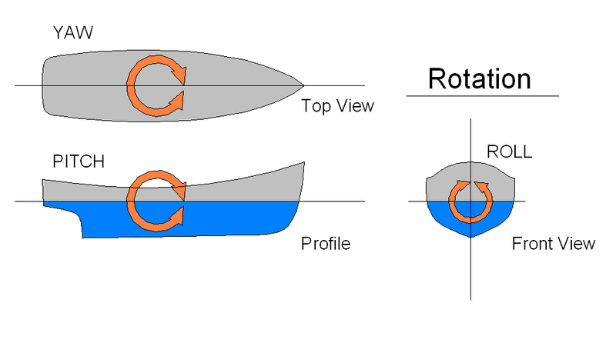
Data
Ship motion in 6 degrees of freedom
Translational
Sway
Surge
Heave
Rotational
Yaw
Pitch
Roll

Slide 7
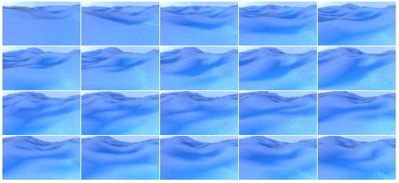
Data
Synthetic data
Generated in a Blender₁ ship-wave simulation
540 episodes of 400 images
Rendered at 2 frames/second
Avoid duplicate data at higher fps
30 hours of simulation
Resolution 96x54
Pitch & roll per image
Optional expansion
Data augmentation
Fog, contrast, …
₁Source: https://github.com/Nazotron1923/ship-ocean_simulation_BLENDER

Slide 8
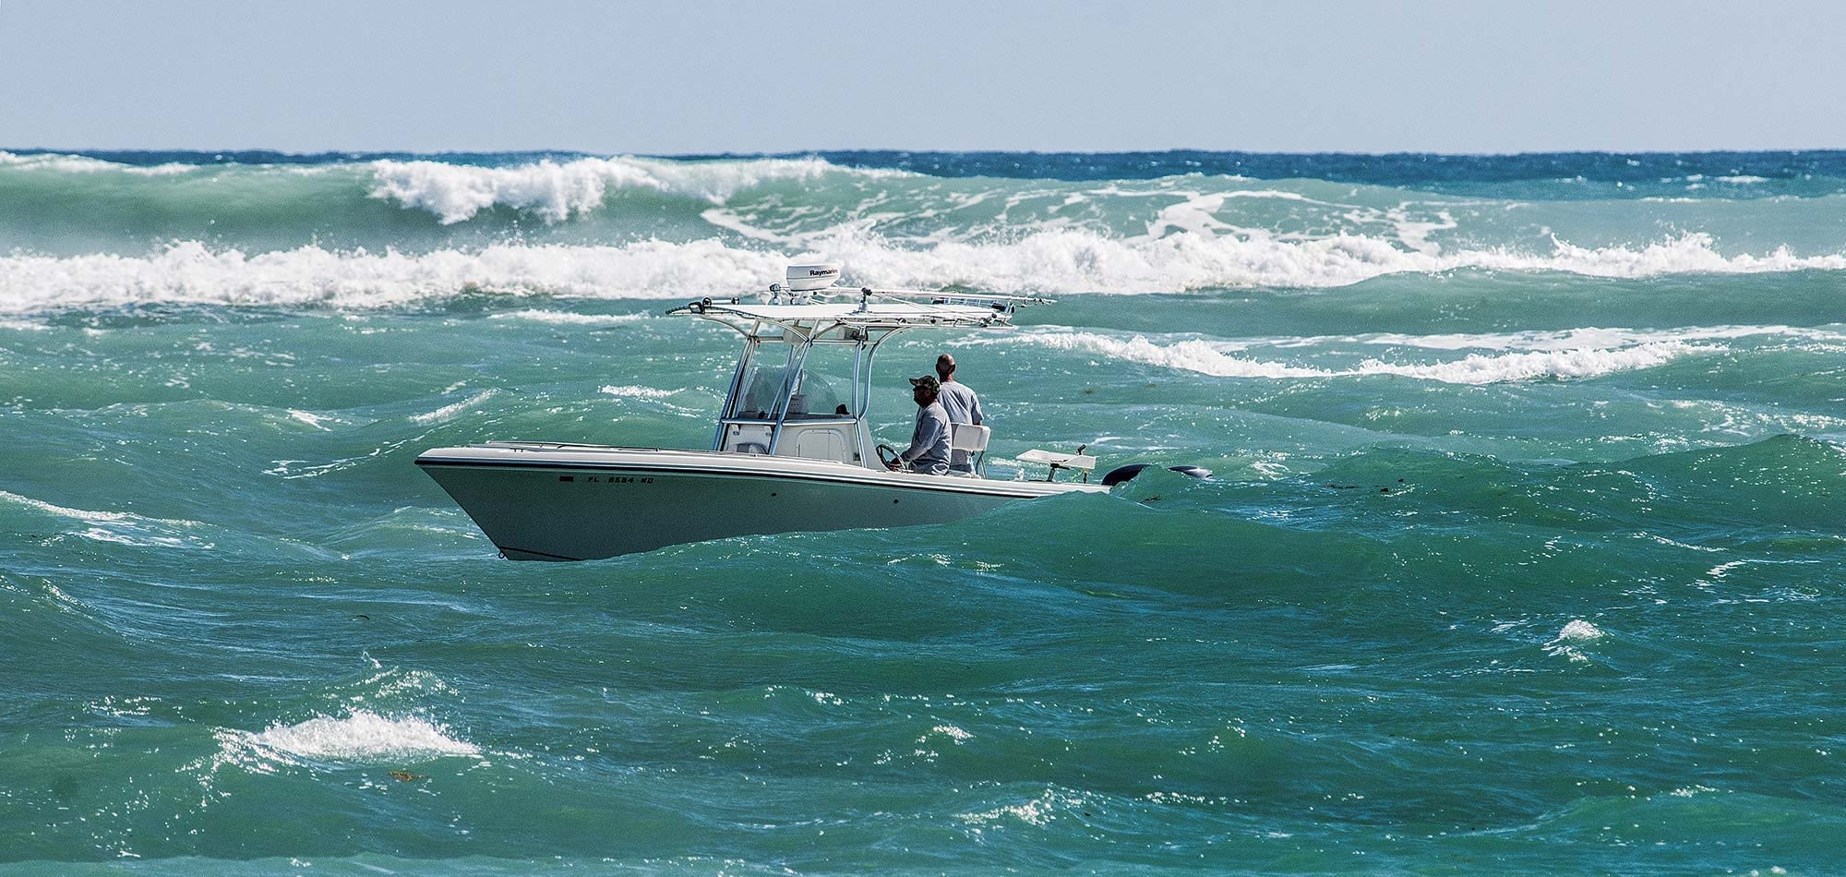
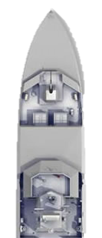
Data
Real data
Live video
Live data from IMU
Additionally
Wind sensor data
Thrust (ASV)
Challenges
Find optimal fps
Objects in images
Stabilization (out of scope)

Slide 9
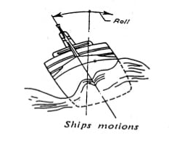
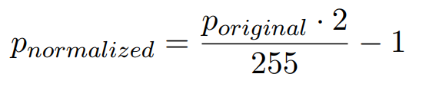
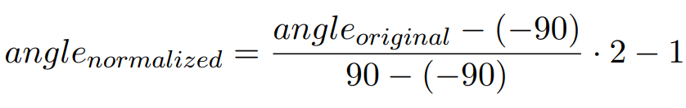
Data Preprocessing
Images need same size, scale and cropping
Already done in generated data set
Pixel values
Normalize to [-1 , 1]:
- Pitch and Roll
Normalize angle with abs values: [-90°, 90°]
Normalize to [-1, 1]:

Slide 10
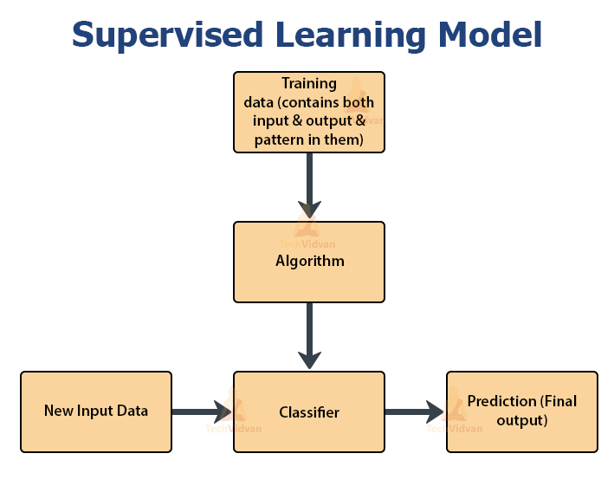
Model training
Supervised learning
Maps an input to an output
Based on examples of input-output pairs
Main components to perform training process

Slide 11
Model training - Parameters
Past window size
Number of seconds of data that is taken to predict pitch and roll (sequence of frames)
Future window size
Future window size - the number of seconds for which pitch and roll will be predicted (sequence of frames)
Number of episodes
The number of episodes used as input data (max 540)
Latent vectors
The dimensions of the latent vectors for the LSTM parts of the model

Slide 12
Model training - Hyperparameters
Learning rate
Determines to what extent newly acquired information overrides old information
Weight decay
Adds a penalty to the error function
Depends on the magnitude of the weights that connect neurons to each other
Used to limit overfitting in a neural network
Batchsize
Defines the number of samples to work through before updating the internal model parameters
Number of Epochs
Defines the number of times that the learning algorithm will work through the entire training dataset

Slide 13
Model training – Data loader
The input is a sequence of images
Models without LSTM module
Length of the sequence = past window size

Slide 14
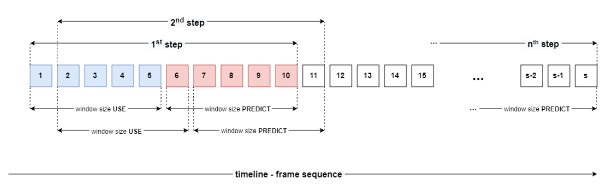
Model training – Data loader
Models with LSTM module
The length of the sequence = [60, 72, 120] frames
Based on used LTSM model
The passage through this sequence is carried out step by step

Slide 15
Model training – Data split
Generated data has increasing complexity
Wave height, wind speed, …
All data sets need data of varying complexity
For best model performance
Every 10% of data is split randomly in
Training data
Validating data
Test data

Slide 16
Model training – Optimization
Training speed optimizer
ADAM algorithm
Early stopping
Prevent overfitting and memory resources
Ready-made solution from github₁
Hyberband
- HyperBand algorithm: mix of grid search and random search
- Only best model’s parameters were individually optimized
₁Source:https://github.com/Bjarten/early-stopping-pytorch

Slide 17
Model Testing

Slide 18
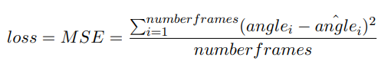
Model testing – Loss function
Regression problem -> Mean Square Error
MSE = sum(distance(target, prediction))
Target: angle
Prediction: angle^

Slide 19
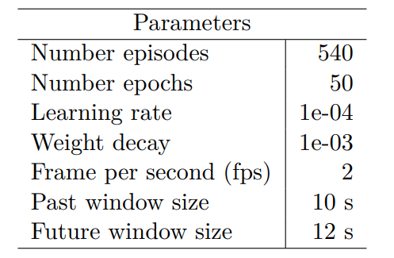
Models testing - parameters
Basic parameters for testing
Hyperband
Only good models

Slide 20
Proposed Models

Slide 21
Introduction – CNN, LSTM
Convolutional Neural Networks - CNN
Analyse images and extract feature
Long Short-Term Memory networks – LSTM
RNN capable of learning long-term dependencies
Process sequences of data
Suited for predicting time series data

Slide 22
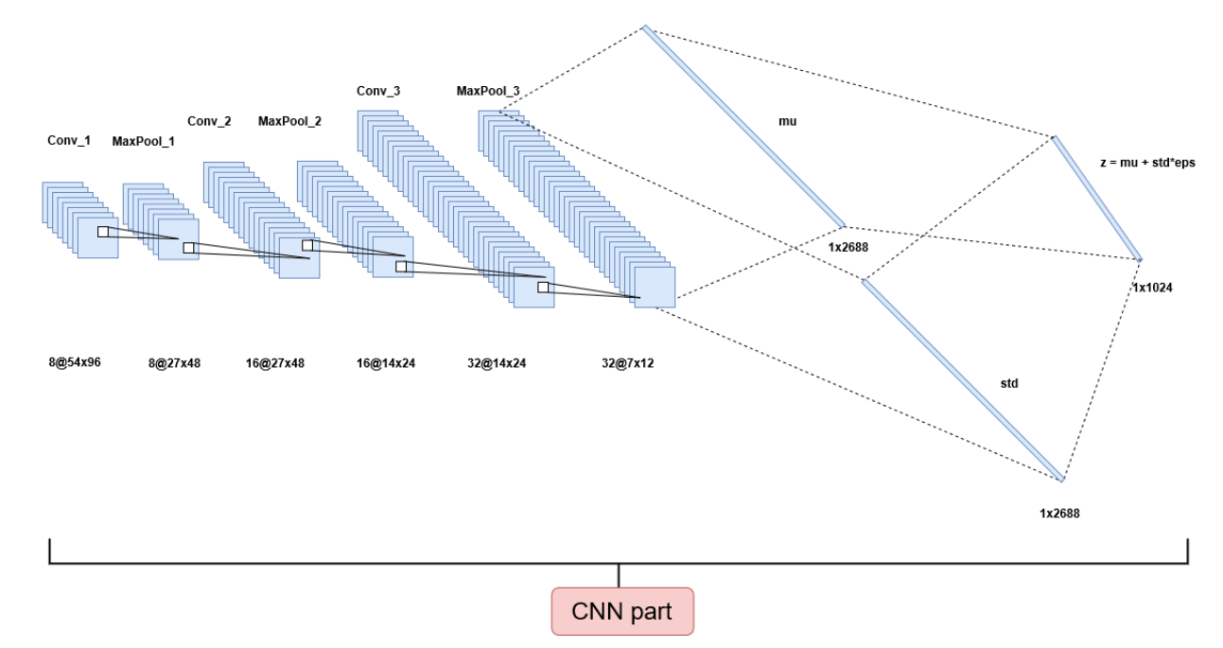
Introduction – Autoencoder
Extract features into vector
Encoder part
Pre-trained component
Greater perfomance
Notes:
9 layers encoder part
Speed up training efficiency

Slide 23
Baseline model

Slide 24
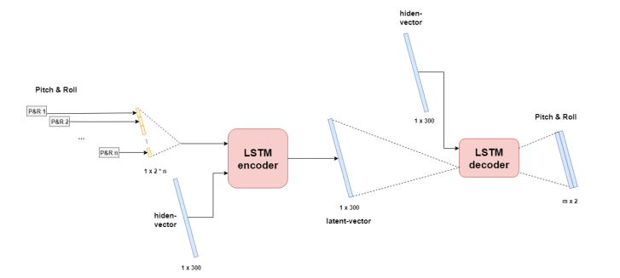
LSTM encoder-decoder PR
Only pitch and roll as input
No images

Slide 25
LSTM encoder-decoder PR - performance
Worst results
Maximum pitch and roll in generated dataset: 62°
MODEL | MSE train x 10² avg over sum pitch and roll | MSE validate x 10² avg over sum pitch and roll | MSE test x 10² avg over sum pitch and roll
LSTM encoder decoder PR | 0.855 | 0.869 | 0.723
MODEL | MSE pitch at 10th sec [denormalized] | MSE pitch at 10th sec [denormalized]
LSTM encoder decoder PR | 30.99° | 29.44°

Slide 26
CNN Models

Slide 27
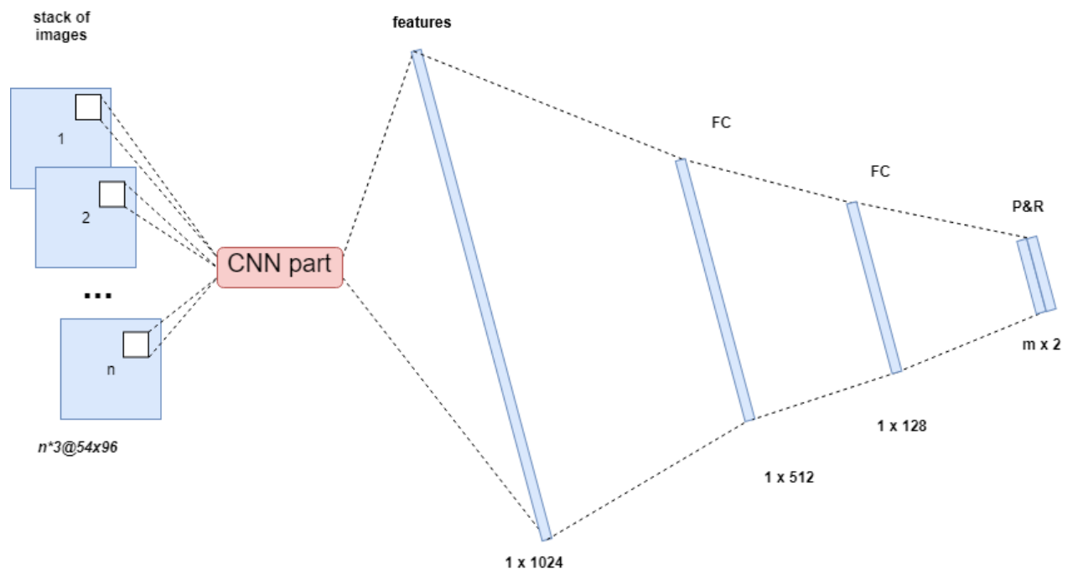
CNN Stack FC model
Fully connected CNN
Input
Stacked images (n)

Slide 28
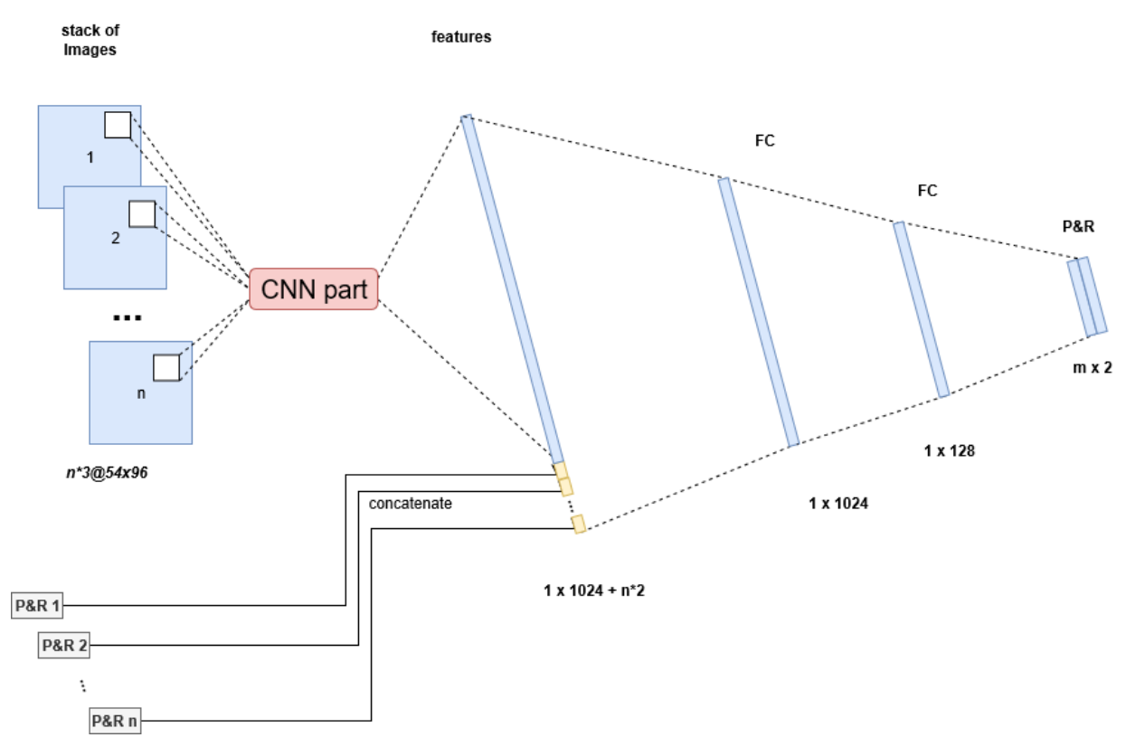
CNN Stack PR FC model
Fully connected CNN
Input
Stacked images (n)
Pitch and roll

Slide 29
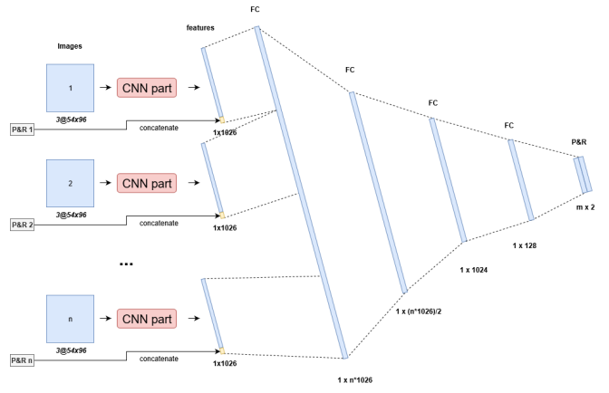
CNN PR FC model
Fully connected CNN
Input
Pitch and roll
Sep. images (n)

Slide 30
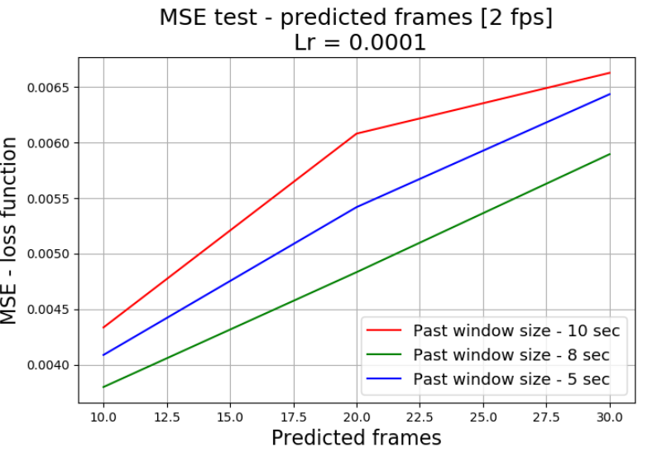
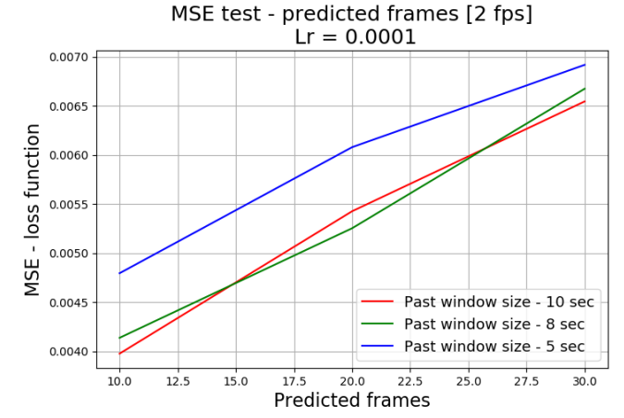
CNN models - performance
Without PR
With PR input
Notes:
Adding pr increases accuracy: average MSE lower with pr
Graphs are from loss function on test set

Slide 31
CNN models - performance
- Separate images greatly improves accuracy
MODEL | MSE train x 10² avg over sum pitch and roll | MSE validate x 10² avg over sum pitch and roll | MSE test x 10² avg over sum pitch and roll
LSTM encoder decoder PR | 0.855 | 0.869 | 0.723
CNN stack FC | 0.635 | 0.647 | 0.619
CNN stack FC PR | 0.556 | 0.470 | 0.483
CNN FC PR | 0.378 | 0.259 | 0.252
Notes:
Adding pr increases accuracy, average MSE lower with pr
Graphs are from loss function on test set

Slide 32
LSTM Models

Slide 33
CNN LSTM img-encoder PR-encoder decoder

Slide 34
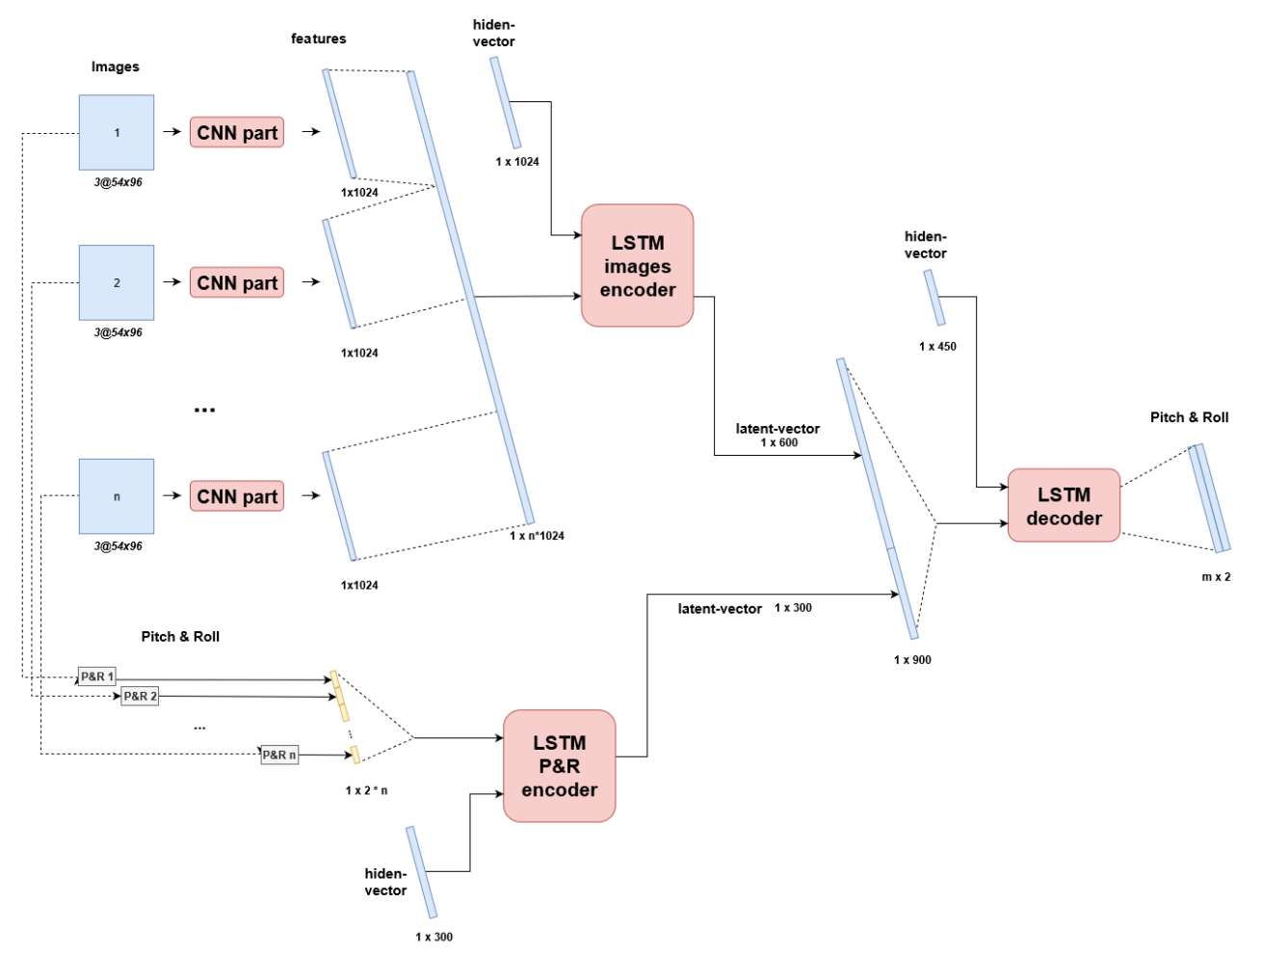
Notes:
Initially, the sequence of frames will be processed by CNN part to extract features.
After that, the features are combined into a vector and fed to the img-encoder (LSTM part).
The pitch and roll sequence is fed separately to the PR-encoder (LSTM part).
One latent vector is generated and decoded by decoder (LSTM part).
The output is a predicted sequence of pitch and roll.

Slide 35
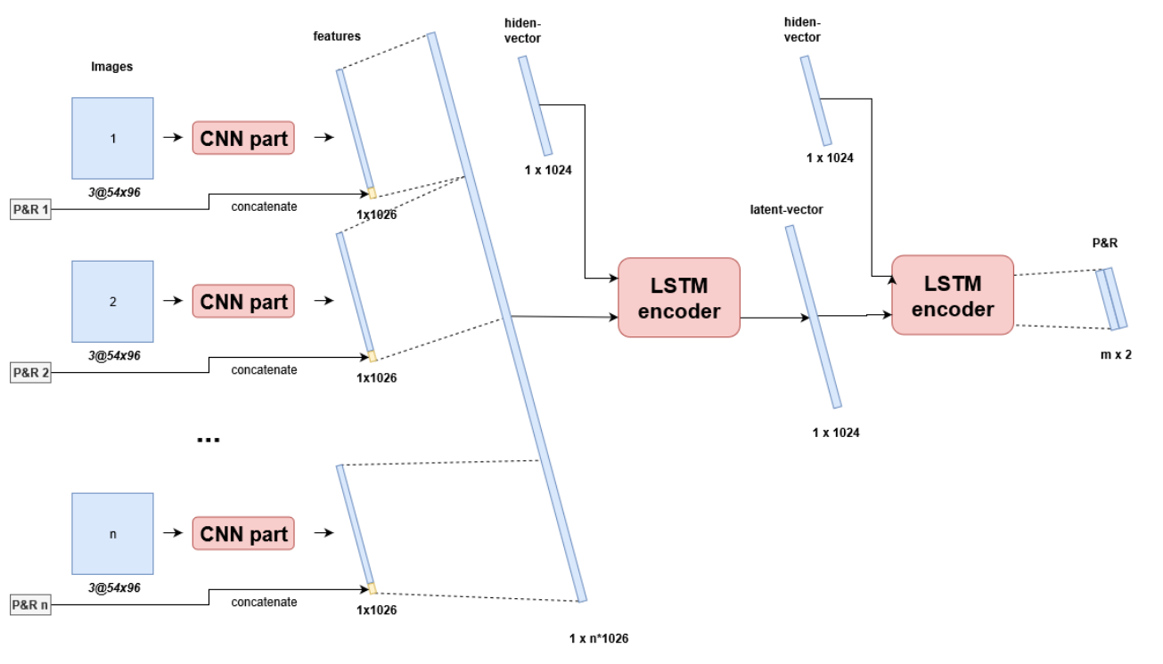
CNN LSTM encoder decoder images PR
Notes:
complexity of the previous model, combine imgencoder and PR-encoder in one encoder element

Slide 36
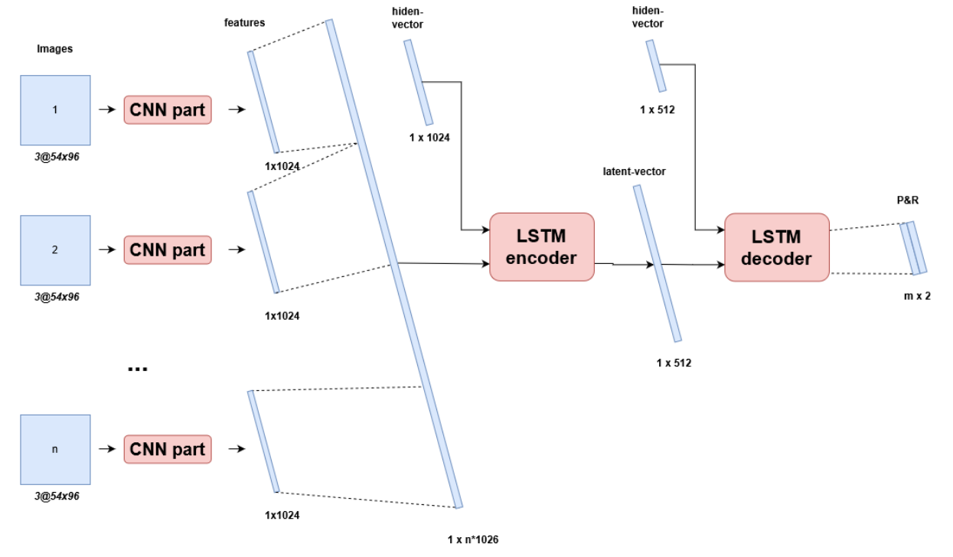
CNN LSTM encoder decoder image
PR dropped
Notes:
Same as last but no additional info PR is used,

Slide 37
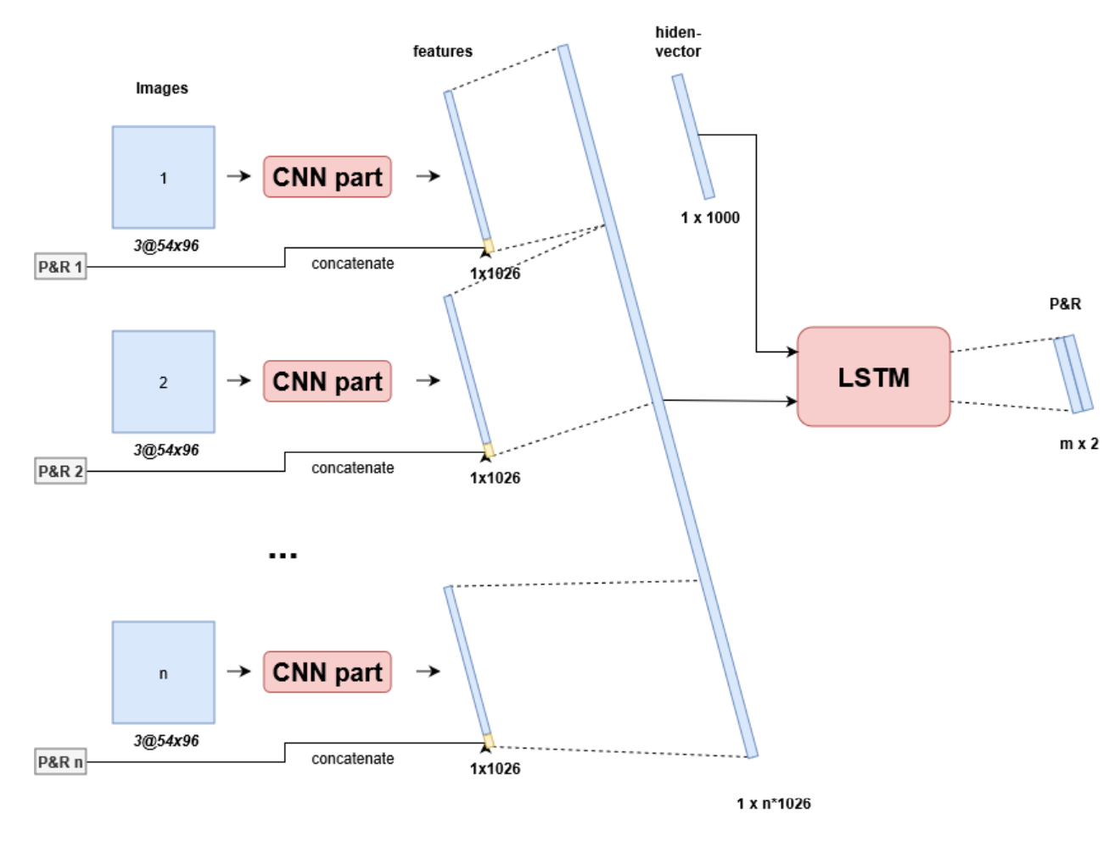
CNN LSTM images PR
Reduce parameters
Notes:
A modification of a previous model.
Combine all LSTM elements into one to
- reduce the parameters of the model
check the efficiency of this configuration
Reduce memory resources

Slide 38
LSTM models - performance
MODEL | MSE train x 10² avg over sum pitch and roll | MSE validate x 10² avg over sum pitch and roll | MSE test x 10² avg over sum pitch and roll
LSTM encoder decoder PR | 0.855 | 0.869 | 0.723
CNN stack FC | 0.635 | 0.647 | 0.619
CNN stack FC PR | 0.556 | 0.470 | 0.483
CNN FC PR | 0.378 | 0.259 | 0.252
CNN LSTM image-encoder PR-encoder decoder | 0.044 | 0.104 | 0.080
CNN LSTM encoder decoder images PR | 0.039 | 0.089 | 0.072
CNN LSTM encoder decoder images | 0.038 | 0.091 | 0.071
CNN LSTM decoder images PR | 0.126 | 0.138 | 0.108
Source: https://github.com/Nazotron1923/Deep_learning_models_for_ship_motion_prediction_from_images/tree/master/Pre
Notes:
Baseline: worst performing model
Green: best perfoming models
- Best performing models are reference for our criteria

Slide 39
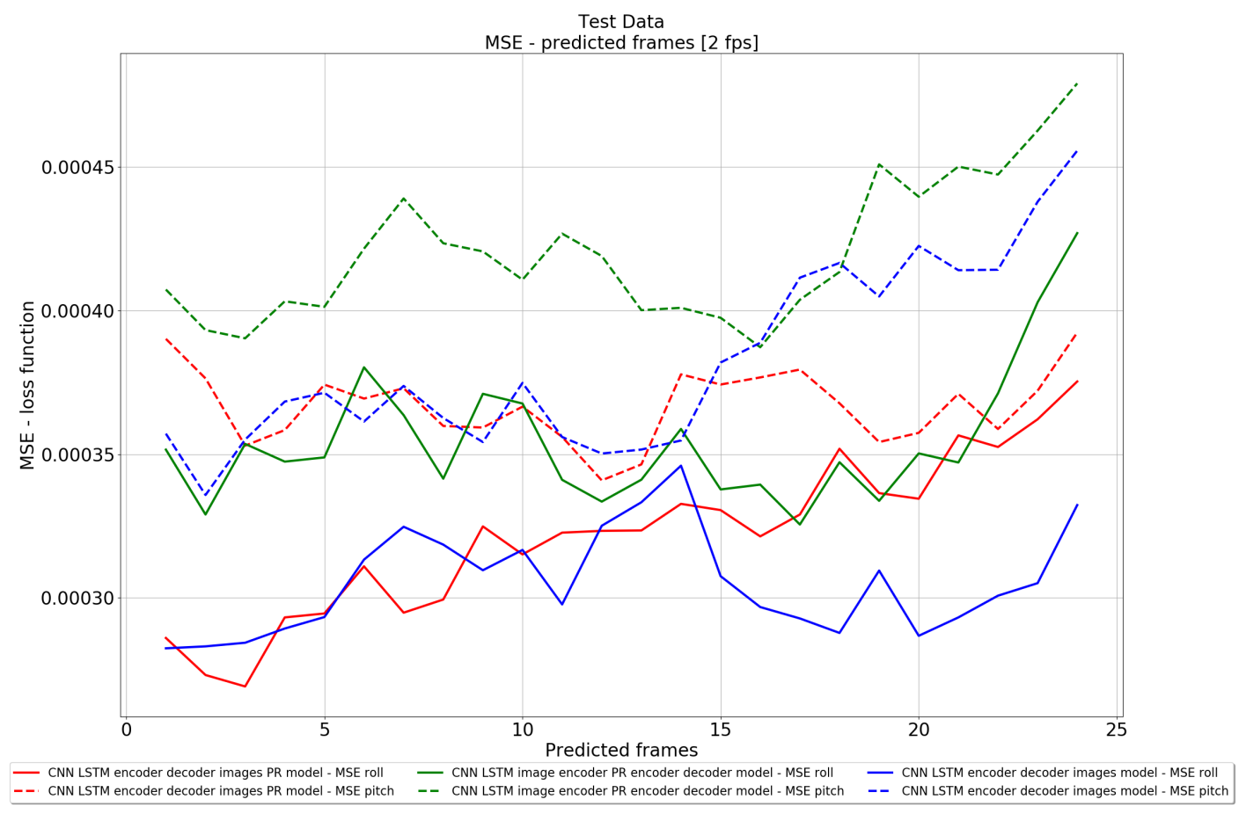
LSTM models - performance
Notes:
MSE roll and Pitch separately
Lower then CNN models
Pitch harder to predict

Slide 40
Denormalized results
MODEL | MSE pitch at 10th sec [denormalized] | MSE pitch at 10th sec [denormalized]
LSTM encoder decoder PR | 30.99° | 29.44°
CNN stack FC | 28.97° | 28.94°
CNN stack FC PR | 21.18° | 22.56°
CNN FC PR | 11.36° | 11.28°
CNN LSTM image-encoder PR-encoder decoder | 3.56° | 2.83°
CNN LSTM encoder decoder images PR | 2.89° | 2.70°
CNN LSTM encoder decoder images | 3.42° | 2.32°
CNN LSTM decoder images PR | 4.22° | 4.16°
Maximum values:
Pitch: 61°
Roll: 62°
Baseline:
Avg: ~30°
50% of max
Reference:
Avg: ~3°
5% of max
Source: https://github.com/Nazotron1923/Deep_learning_models_for_ship_motion_prediction_from_images/tree/master/Pre
Notes:
Max 90 degrees
So good results

Slide 41
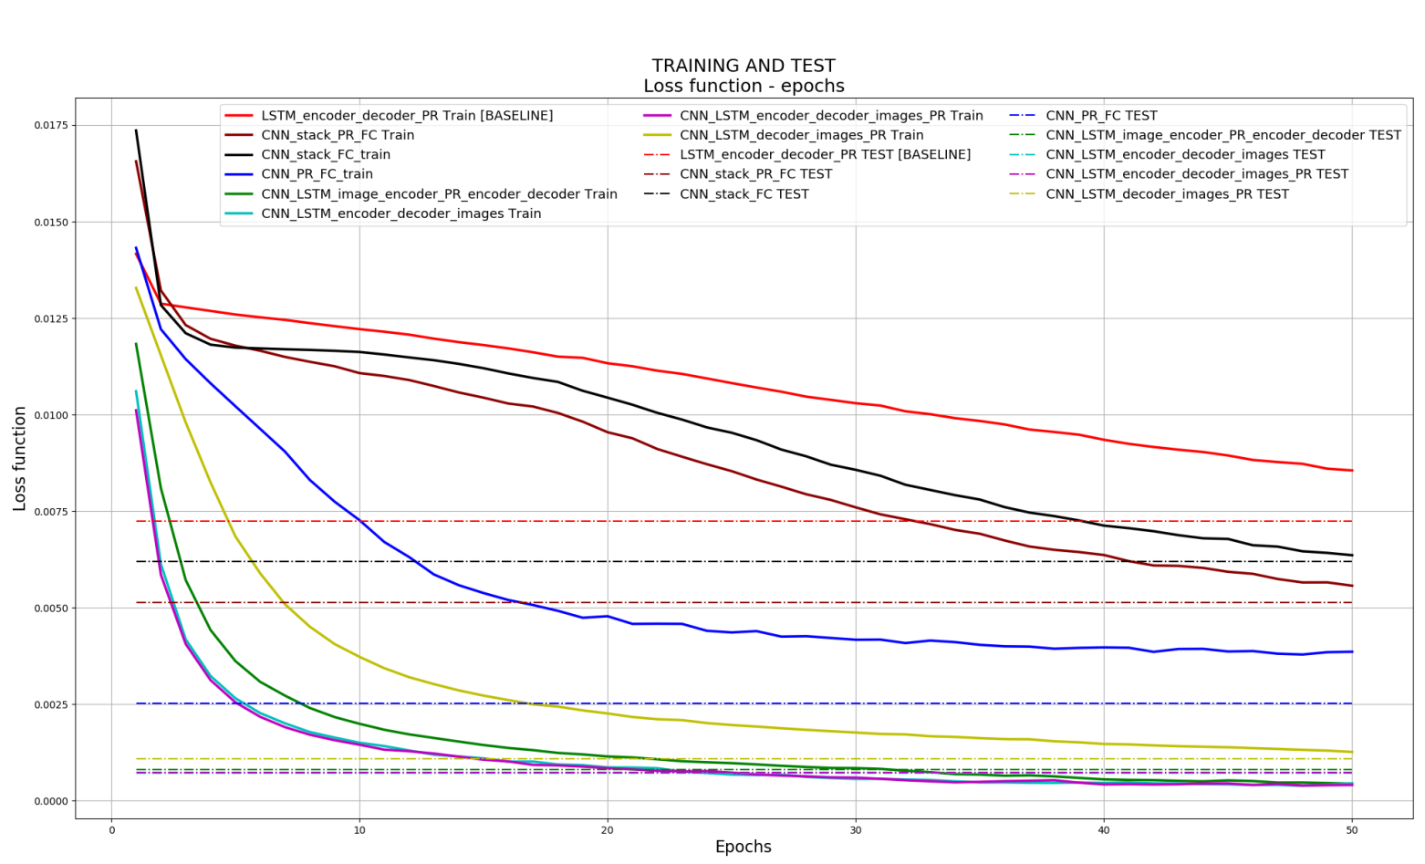
Convergence
Notes:
First models bad convergence
Training data training
Average MSE

Slide 42
Best model
Compare accuracy over large amount of predicted frames

Slide 43
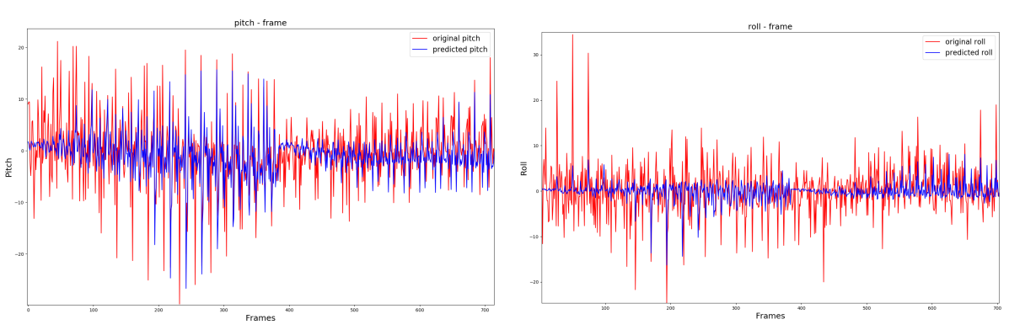
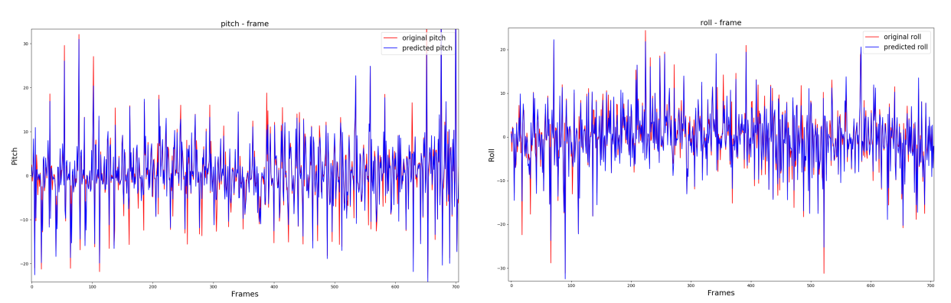
Without PR
With PR

Slide 44
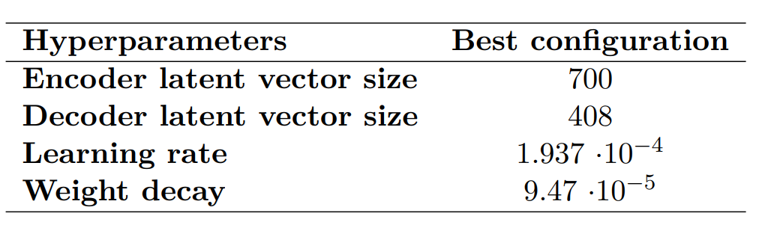
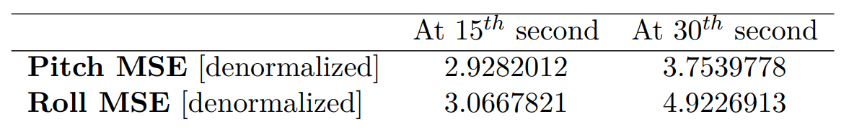
Hyperband optimization
Test best model with optimized hyperparameters
Final test up to 30 seconds

Slide 45
Conclusion
CNN LSTM encoder decoder images PR
Criteria
MSE avg [0.0004; 0.0009] good results
3° / 5% accuracy at 10th second
4° / 7% accuracy at 15th second
5° / 8% accuracy at 30th second
CNN LSTM encoder decoder images PR | 0.00039 MSE | 0.00089 MSE | 0.00072 MSE
 | 10th second | 15th second | 30th second
Pitch | 2.89° | 2.92° | 3.06°
Roll | 2.71° | 3.75° | 4.92°

Slide 46
Implementation (2nd semester)
Test against 0 baseline
Use existing models with augmented data
Use existing models with real data
Define time criteria: real-time predictions
Extra output parameter: heave
Compare results
Develop and test new models
Compare with criteria
GRU + CNN
Transformer + CNN: GPT3

Slide 47
Questions

Slide 48
Sources
Deep Learning For Predicting Ship Motion From Images – Nazar-Mykola Kaminskyi - https://github.com/Nazotron1923/Deep_learning_models_for_ship_motion_prediction_ from_images/
Real-Time Ship Motion Forecasting Using Deep Learning – 2021 – Mohammad Hasanur Rashid, Jing Zhang, Minghao Zhao - https://dl.acm.org/doi/abs/10.1145/3448734.3450923
A Neural Conversational Model – 2015 - Oriol Vinyals, Quoc Le - https://arxiv.org/abs/1506.05869
A Co-operative Hybrid Model For Ship Motion Prediction - R. Skulstad, G. Li, T. I. Fossen, T. Wang, H. Zhang - https://www.researchgate.net/publication/351397594_A_Cooperative_Hybrid_Model_For_Ship_Motion_Prediction

